Slide 1
Python

Slide 2
Introduction to Python
Python is a high-level programming language
Open source and community driven
Dynamic typed
Interpreted
Source can be compiled or run just-in-time

Slide 3
Why Python?
Large base of developers already using the language
Can interface with the Component Object Model (COM) used by Windows
For Automation
Linux Scripting
Large Set of Libraries
Rapid Development

Slide 4
Python Interfaces
IDLE – a cross-platform Python development environment
PythonWin – a Windows only interface to Python
Python Shell – running 'python' from the Command Line opens this interactive shell

Slide 5
Features
Interpreted
You run the program straight from the source code.
Python program →Bytecode →a platforms native language
You can just copy over your code to another system and it will auto-magically work! *with python platform
Object-Oriented
Simple and additionally supports procedural programming
Extensible – easily import other code
Embeddable –easily place your code in non-python programs
Extensive libraries
(i.e. reg. expressions, doc generation, CGI, ftp, web browsers, ZIP, WAV, cryptography, etc...) (wxPython, Twisted, Python Imaging library)

Slide 6
Example Python
Hello World
print(“hello world”)
Prints hello world to standard out

Slide 7
More than just printing
Python is an object oriented language
Practically everything can be treated as an object
“hello world” is a string
Strings, as objects, have methods that return the result of a function on the string

Slide 8
Basic operations
Assignment:
size = 40
a = b = c = 3
Numbers
integer, float
complex numbers: 1j+3
Strings
'hello world', 'it\'s hot'
"bye world"
continuation via \ or use """ long text """"

Slide 9
String Methods
Assign a string to a variable
In this case “hw”
hw.title()
hw.upper()
hw.isdigit()
hw.islower()

Slide 10
String operations
concatenate with + or neighbors
word = 'Help' + x
word = 'Help' 'a'
subscripting of strings
'Hello'[2] → 'l'
slice: 'Hello'[1:2] → 'el'
word[-1] → last character
len(word) → 5
"hello"*3

Slide 11
Other Python Objects
Lists (mutable sets of strings)
var = [] # create list
var = [‘one’, 2, ‘three’, ‘banana’]
Tuples (immutable sets)
var = (‘one’, 2, ‘three’, ‘banana’)
Dictionaries (associative arrays or ‘hashes’)
var = {} # create dictionary
var = {‘lat’: 40.20547, ‘lon’: -74.76322}
var[‘lat’] = 40.2054
Each has its own set of methods

Slide 12
Lists
Think of a list as a stack of cards, on which your information is written
The information stays in the order you place it in until you modify that order
Methods return a string or subset of the list or modify the list to add or remove components
Written as var[index], index refers to order within set (think card number, starting at 0)
You can step through lists as part of a loop

Slide 13
List Methods
Adding to the List
var[n] = object
replaces n with object
var.append(object)
adds object to the end of the list
Removing from the List
var[n] = []
empties contents of card, but preserves order
var.remove(n)
removes card at n
var.pop(n)
removes n and returns its value

Slide 14
Examples
lists can be heterogeneous
a = ['spam', 'eggs', 100, 1234, 2*2]
Lists can be indexed and sliced:
a[0] → spam
a[:2] → ['spam', 'eggs']
Lists can be manipulated
a[2] = a[2] + 23
a[0:2] = [1,12]
a[0:0] = []
len(a) → 5

Slide 15
Tuples
Like a list, tuples are iterable arrays of objects
Tuples are immutable – once created, unchangeable
To add or remove items, you must redeclare
Example uses of tuples
County Names
Land Use Codes
Ordered set of functions

Slide 16
Tuples and sequences
lists, strings, tuples: examples of sequence type
tuple = values separated by commas
>>> t = 123, 543, 'bar'
>>> t[0]
123
>>> t
(123, 543, 'bar')

Slide 17
Tuples
Tuples may be nested
>>> u = t, (1,2)
>>> u
((123, 542, 'bar'), (1,2))
kind of like structs, but no element names:
(x,y) coordinates
database records
like strings, immutable → can't assign to individual items

Slide 18
Tuples
Empty tuples: ()
>>> empty = ()
>>> len(empty)
0
one item → trailing comma
>>> singleton = 'foo',

Slide 19
Dictionaries
Dictionaries are sets of key & value pairs
Allows you to identify values by a descriptive name instead of order in a list
Keys are unordered unless explicitly sorted
Keys are unique:
var[‘item’] = “apple”
var[‘item’] = “banana”
print var[‘item’] prints just banana

Slide 20
x = var.get("model")
Print Keys:
for x in var:
print(x)
Print Values:
for x in var:
print(var[x])
Print Values:
for x in var.values():
print(x)
Print both key-value:
for x, y in var.items():
print(x, y)
Remove value
var.pop("model")
var.popitem() #last item
del thisdict["model"]
del var

Slide 21
Empty Dictionary
var.clear()
Copy Dictionary
d = var.copy()
d = dict(var)
Create Dictionary
d=dict(name=’sid’,state=’MH’)

Slide 22
Indentation and Blocks
Python uses whitespace and indents to denote blocks of code
Lines of code that begin a block end in a colon:
Lines within the code block are indented at the same level
To end a code block, remove the indentation
You'll want blocks of code that run only when certain conditions are met

Slide 23
Control flow: if
x = int(raw_input("Please enter #:"))
if x < 0:
x = 0
print 'Negative changed to zero'
elif x == 0:
print 'Zero'
elif x == 1:
print 'Single'
else:
print 'More'
no case statement

Slide 24
Control flow: for
a = ['cat', 'window', 'defenestrate']
for x in a:
print x, len(x)
no arithmetic progression, but
range(10) → [0, 1, 2, 3, 4, 5, 6, 7, 8, 9]
for i in range(len(a)):
print i, a[i]
do not modify the sequence being iterated over

Slide 25
Loops: break, continue, else
break and continue like C
else after loop exhaustion
for n in range(2,10):
for x in range(2,n):
if n % x == 0:
print n, 'equals', x, '*', n/x
break
else:
# loop fell through without finding a factor
print n, 'is prime'

Slide 26
While loop
a,b = 0, 1
# non-zero = true
while b < 10:
# formatted output, without \n
print b,
# multiple assignment
a,b = b, a+b

Slide 27
Do nothing
pass does nothing
syntactic filler
while 1:
pass

Slide 28
Reference Sementics
Assignment manipulates references
x = y does not make a copy of y
x = y makes x reference the object y references
Very useful; but beware!
Example:
>>> a = [1, 2, 3]
>>> b = a
>>> a.append(4)
>>> print b
[1, 2, 3, 4]

Slide 29
Changing a Shared List
a
1
2
3
a = [1, 2, 3]
a
1
2
3
b = a
b
a
1
2
3
a.append(4)
4
b

Slide 30
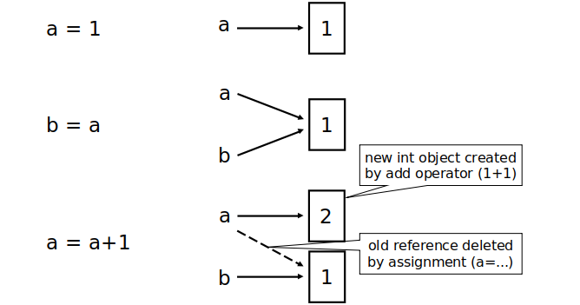
Changing an Integer

Slide 31
Operators
Python Airthmatic Operators
+,-,/,*,%,**,//
Assignment operators
=,+= and so on
Comparison Operators
==,!=,<,>,>=,<=
Logical Operators
and,or,not

Slide 32
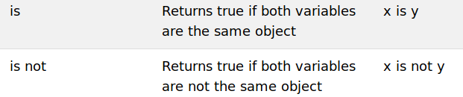
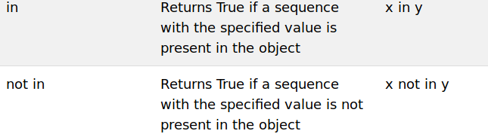
Identity Operator
Membership Operator

Slide 33
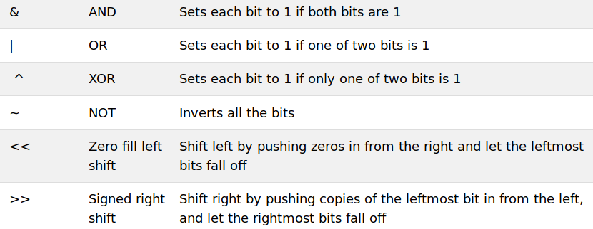
Bitwise Operator

Slide 34
Defining functions
def fib(n):
"""Print a Fibonacci series up to n."""
a, b = 0, 1
while b < n:
print b,
a, b = b, a+b
>>> fib(2000)
First line is docstring
first look for variables in local, then global
need global to assign global variables

Slide 35
Functions: default argument values
def ask_ok(prompt, retries=4, complaint='Yes or no, please!'):
while 1:
ok = raw_input(prompt)
if ok in ('y', 'ye', 'yes'): return 1
if ok in ('n', 'no'): return 0
retries = retries - 1
if retries < 0: raise IOError, 'refusenik error'
print complaint
>>> ask_ok('Really?')

Slide 36
Keyword arguments
last arguments can be given as keywords
def parrot(voltage, state='a stiff', action='voom', type='Norwegian blue'):
print "-- This parrot wouldn't", action,
print "if you put", voltage, "Volts through it."
print "Lovely plumage, the ", type
print "-- It's", state, "!"
parrot(1000)
parrot(action='VOOOM', voltage=100000)

Slide 37
Modules
Modules are additional pieces of code that further extend Python’s functionality
A module typically has a specific function
additional math functions, databases, network…
Python comes with many useful modules
arcgisscripting is the module we will use to load ArcGIS toolbox functions into Python

Slide 38
Modules
Modules are accessed using import
import sys, os # imports two modules
Modules can have subsets of functions
os.path is a subset within os
Modules are then addressed by modulename.function()
sys.argv # list of arguments
filename = os.path.splitext("points.txt")
filename[1] # equals ".txt"

Slide 39
Example
Create One file greeting.py and write following code.
def greet(name):
print("Hello, " + name)
person= {
"name": "sid",
"country": "India"
}

Slide 40
Create another file main.py and import the module
import greet
greet.greeting("Siddhant")
print(greet.person[name])
Create alias of module
import greet as gt
gt.greeting(“Siddhant”)

Slide 41
We can import from module
from greet import person
print(greet.person[name])

Slide 42
Lambda Functions
A small anonymous function.
Can take any number of arguments, but can only have one expression
lambda arguments : expression
e.g
sum = lambda x, y : x +y
print(sum(5, 6))

Slide 43
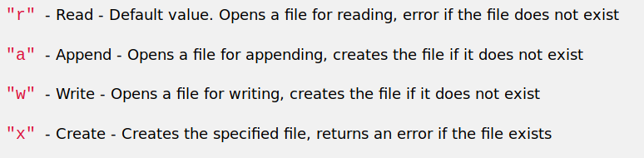
File Handling
To open file
f = open("demo.txt", "rt")
open() function takes two parameters; filename, and mode

Slide 44
Two more modes
‘t’ for text mode
‘b’ for binary mode
To read file:
f.read()
f.read(5) # 5 character of file
f.readline() # read one line at a time
To close file
f.close()
To write into file
f.write("Sample content")

Slide 45
Class/Object
A Class is like an object constructor
A "blueprint" for creating objects
Create class using class keyword
class Sample:
a = 100
obj = Sample()
print(obj.a)

Slide 46
__init__ function
All classes have a function called __init__()
It is always executed when the class is being initiated.
Use the __init__() function to assign values to object properties, or other operations that are necessary to do when the object is being created

Slide 47
class Person:
def __init__(self, name, country):
self.name = name
self.country = country
def myf(self):
print("My name is : " + self.name)
p = Person("sid", “India”)
print(p.name)
print(p.country)
p.myf()

Slide 48
The self parameter is a reference to the current instance of the class
It is used to access variables that belongs to the class.
Delete object property
del p.name
Delete Object
del p

Slide 49
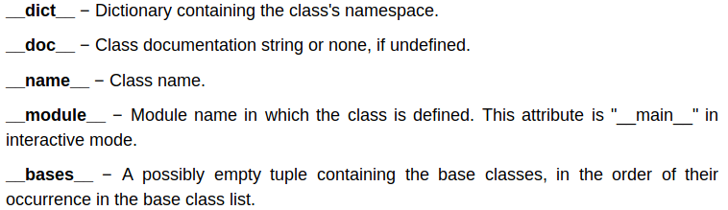
Class built-in attributes
Person.__doc__

Slide 50
Inheritance
Inheritance allows us to define a class that inherits all the methods and properties from another class.
The child class inherits the attributes of its parent class,
class SubClassName (ParentClass1[, ParentClass2, ...])

Slide 51
Create child class
class Child(Person): # define child class
def __init__(self):
print "Calling child constructor"
def childMethod(self):
print 'Calling child method'
c = Child() # instance of child
c.childMethod() # child calls its method
c.myf()

Slide 52
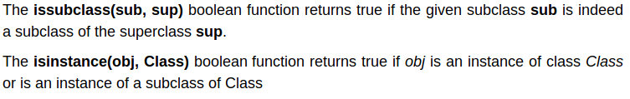
Method Overriding:Changing definition of method in child class
class Child(Person):
def myf(self):
print("Overrided method”)

Slide 53
Method Overloading:Changing the signature of method and definition also
(Use Multimethod library for method overloading)
Encapsulation: data hiding
name attributes with a double underscore prefix, and those attributes then are not be directly visible to outsiders.
__name=”sid”

Slide 54
Few methods
__init__(self) -Constructor
__del__(self)-Destructor,deletes an object
__repr__(self)-Evaluable string repersentation
__str__(self)-Printable String reperentation
__cmp__(self)-Object Comparison

Slide 55
JSON
import json
x = '{ "name":"sid", "city":”Pune"}'
y = json.loads(x)
print(y["name"])
y = json.dumps(x)#Convert dictionary to json

Slide 56
Regular Expression
It is a sequence of characters that forms a search pattern
The module re provides full support for regular expression
import re
Check string starting with ‘This’ and ending with ‘str’
txt = "This is sample str"
x = re.search("^This.*str$", txt)

Slide 57
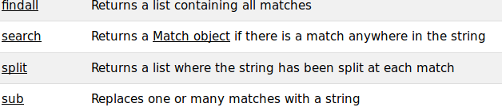
RegEx methods:

Slide 58
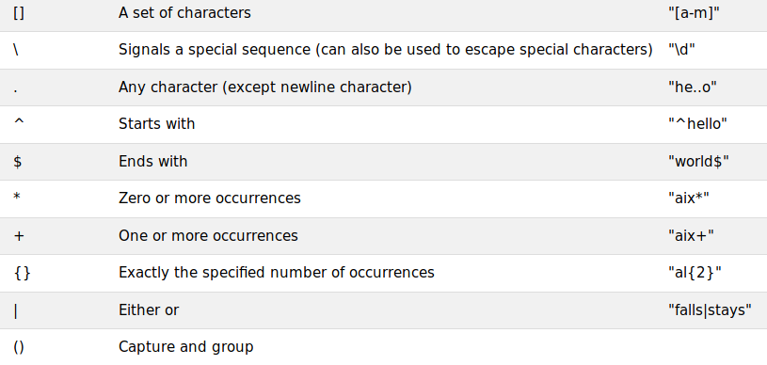
Metacharacters

Slide 59
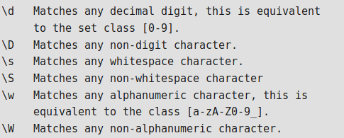

Slide 60
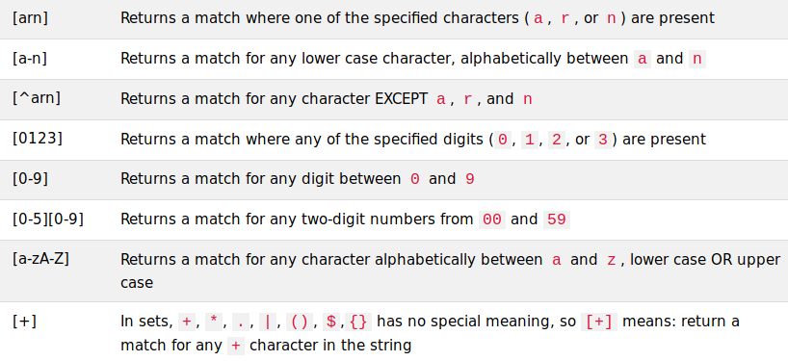

Slide 61
Datetime
Date in Python is not a data type of its own, but we can import a module named datetime
import datetime
x = datetime.datetime.now() # current time
print(x)
print(x.year)
To store your date
x = datetime.datetime(2019, 5, 20)

Slide 62
Error Capture
Check for type assignment errors, items not in a list, etc.
Try & Except
try:
a block of code that might have an error
except: code to execute if an error occurs in "try"

Slide 63
try:
print(x)
except:
print("An exception occurred")

Slide 64
try:
print(x)
except NameError:
print("Variable x is not defined")
except:
print("Something went wrong")

Slide 65
Some Common Error
IOError
ImportError
ValueError
Keyboard Interrupt
EOFError

Slide 66
The finally block, if specified, will be executed regardless if the try block raises an error or not
try:
print(x)
except:
print("Something went wrong")
finally:
print("This is finished")

Slide 67
OS -Module
This module provides a portable way of using operating system dependent functionality
Extensions peculiar to a particular operating system are also available through the os module, but using them is of course a threat to portability.
All functions accepting path or file names accept both bytes and string objects, and result in an object of the same type, if a path or file name is returned.
All functions in this module raise OSError

Slide 68
os.chdir(path)
os.getcwd()
os.getenv(key, default=None)
Return the value of the environment variable key if it exists, or default if it doesn’t. key, default and the result are str.
os.getlogin()
Return the name of the user logged in on the controlling terminal of the process.
os.popen(cmd, mode='r', buffering=-1)
Open a pipe to or from command cmd. The return value is an open file object connected to the pipe, which can be read or written depending on whether mode is 'r' (default) or 'w'.

Slide 69
Set
A set is a collection which is unordered and unindexed of unique elements
Like other collections, sets support x in set, len(set), and for x in set. Being an unordered collection, sets do not record element position or order of insertion.

Slide 70
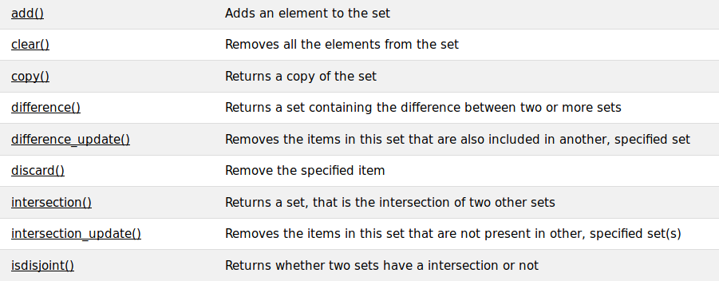

Slide 71
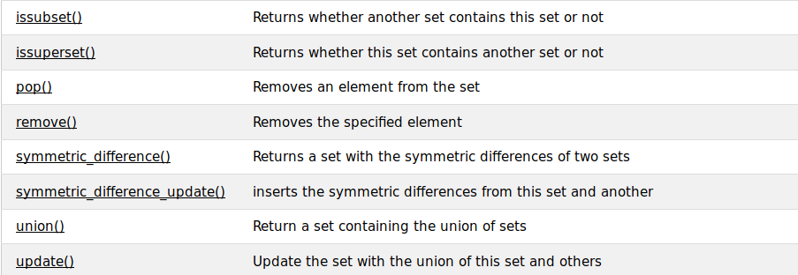

Slide 72
Miscellenous Syntax
seq[start:end:step]
range(100)[5:18:2]
[5, 7, 9, 11, 13, 15, 17]
Loops
numbers = [1, 2, 3, 5, 7]
squares = (n**2 for n in numbers)

Slide 73
my_list = [ 2, 5, 6 ]
new_list = [ item+1 for item in my_list ]
print(new_list)
with open('output.txt', 'w') as file: # Use file to refer to the file object
file.write('Hi there!')

Slide 74
eval(expression, globals, locals)
expression :A String, that will be evaluated as Python code
globals :(Optional) A dictionary containing global parameters
locals :(Optional)A dictionary containing local parameters

Slide 75
Package
Create a folder for package
e.g. Sample
Write python methods inside the Sample folder like Diot.py and add.py
Create a __init__.py inside the Sample folder and import all the python modules
Then call the Package with folder name
e.g import Sample

Slide 76
Additional Python Resources
Python Homepage http://www.python.org/
Dive Into Python http://www.diveintopython.org/
Learning Python, 3rd Edition http://www.oreilly.com/catalog/9780596513986/

